Slide 1
Introduction to MATLAB

Slide 2
Outline
What is Matlab?
Matlab Screen
Variables, array, matrix, indexing
Operators (arithmetic, relational, logical, symbolic )
Display Facilities
Flow Control
Symbolic Operations
Using of M-File
Writing User Defined Functions
Matlab Help

Slide 3
What is MATLAB
MATLAB (MATrix LABoratory)
High-performance language for technical computation, visualization, and programming in an easy-to-use environment.

Slide 4
Why MATLAB
A good choice for vision program development because:
Easy to do very rapid prototyping
Quick to learn, and good documentation
A good library of image & signal processing functions
Excellent display capabilities
Widely used for teaching and research in universities and industry

Slide 5
Typical Uses of MATLAB
Math and computation
Algorithm development
Modelling, simulation, and prototyping
Data analysis, exploration, and visualization
Scientific and engineering graphics
Application development, including Graphical User Interface building

Slide 6
MATLAB Consists
The MATLAB language
A high-level matrix/array language with control flow statements, functions, data structures, input/output, and object-oriented programming features.
The MATLAB working environment
The set of tools and facilities that you work with as the MATLAB user or programmer includes tools for developing, managing, debugging, and profiling.

Slide 7
Handle Graphics
The MATLAB graphics system. It includes high-level commands for two-dimensional and three-dimensional data visualization, image processing, animation, and presentation graphics.
The MATLAB Application Program Interface (API)
Library that allows you to write C and Fortran programs that interact with MATLAB. It include facilities for calling routines from MATLAB (dynamic linking), calling MATLAB as a computational engine, and for reading and writing MAT-files.

Slide 8
The MATLAB function library
A vast collection of computational algorithms ranging from elementary functions like sum, sine, cosine, and complex arithmetic, to more sophisticated functions like matrix inverse, matrix eigen values, Bessel functions, and fast Fourier transforms as well as special image processing related functions

Slide 9
Some facts for first impression
Everything in MATLAB is a matrix.
MATLAB is an interpreted language.
MATLAB does not need any variable declarations, no dimension statements, has no packaging, no storage allocation, no pointers.
Programs can be run step by step, with full access to all variables, functions etc.

Slide 10
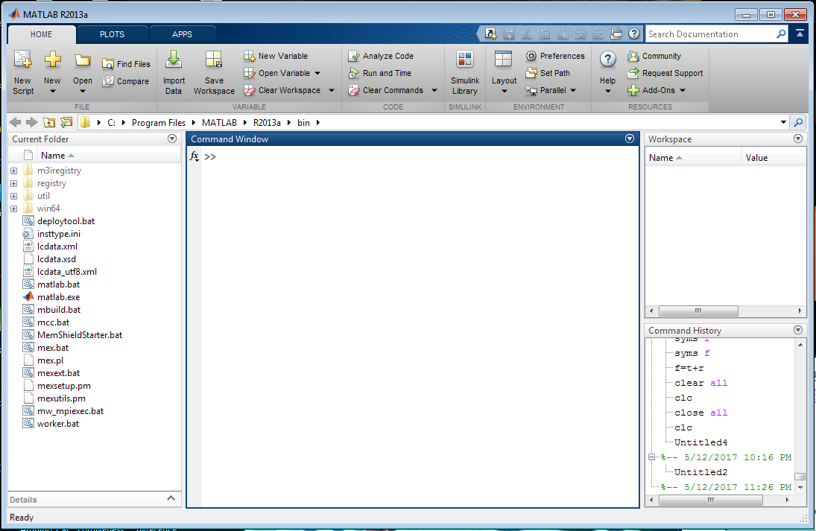
MATLAB Screen
workspace
Command Window
Current Folder
Command History

Slide 11
Practice
a vector >>x = [1 2 5 1]
x =
1 2 5 1
a matrix >>z = [1 2 3; 5 1 4; 3 2 -1]
z =
1 2 3
5 1 4
3 2 -1
transpose >>y = x’ y = 1
2
5
1

Slide 12
Practice
No need for types. i.e.,
All variables are created with double precision unless specified and they are matrices.
After these statements, the variables are 1x1 matrices with double precision
int a;
double b;
float c;
Example:
>>x=5;
>>x1=2;

Slide 13
Practice
>>t =1:10
t =
1 2 3 4 5 6 7 8 9 10
>>k =2:-0.5:-1
k =
2 1.5 1 0.5 0 -0.5 -1
>>B = [1:4; 5:8]
x =
1 2 3 4
5 6 7 8

Slide 14
Practice
>>x = [1 2], y = [4 5], z=[ 0 0]
>>A = [x y]
1 2 4 5
>>B = [x ; y]
1 2
4 5
C = [x y ;z]
Error:
??? Error using ==> vertcat CAT arguments dimensions are not consistent.

Slide 15
Matrix Indices
The matrix indices begin from 1 (not 0 (as in C))
The matrix indices must be positive integer
>>A=[1 2 3;4 5 6;7 8 9]
A= >>A(6) >>A(3,2) >>A(2,:)
1 2 3 ans= 8 ans= 8 ans= 4 5 6
4 5 6 >>A(1:2,2)
7 8 9 ans= 2
5
>>A(-2), A(0)
Error: ??? Subscript indices must either be real positive integers or logicals.
>>A(4,2)
Error: ??? Index exceeds matrix dimensions.

Slide 16
Operators
+ addition
- subtraction
* multiplication
/ division
^ power
‘ complex conjugate transpose

Slide 17
Matrices Operations
Given A and B
>>A=[1 2 3;4 5 6;7 8 9] >>B=[3 5 2;5 2 8;3 6 9]
A = B=
1 2 3 3 5 2
4 5 6 5 2 8
7 8 9 3 6 9
>>x=A+B >>y=A-B
x= 4 7 5 y= -2 -3 1
9 7 14 -1 3 -2
10 14 18 4 2 0

Slide 18
Matrices Operations
>>z=A*B >>T=A’
z= 22 27 45 T= 1 4 7
55 66 102 2 5 8
88 105 159 3 6 9

Slide 19
Operators (element by element)
.* element-by-element multiplication
./ element-by-element division
.^ element-by-element power
The use of “.” – “Element” Operation

Slide 20
>>A = [1 2 3; 5 1 4; 3 2 1]
A =
1 2 3
5 1 4
3 2 -1
>>x = A(1,:)
x=
1 2 3
>>y = A(3 ,:)
y=
3 2 -1
>>b = x .* y
b=
3 4 -3
>>c = x . / y
c=
0.33 1 -3
>>d = x .^2
d=
1 4 9
>>K= x^2
Erorr: ??? Error using ==> mpower Matrix must be square.
>>B=x*y
Erorr:??? Error using ==> mtimes Inner matrix dimensions must agree.

Slide 21
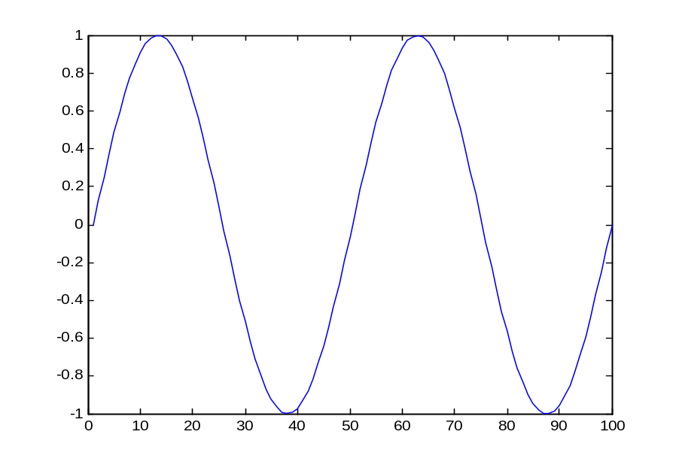
Plots
Plot the function sin(x) between 0≤x≤4π
Create an x-array of 100 samples between 0 and 4π.
>>x=linspace(0,4*pi,100);
>>y=sin(x);
>>plot(y)

Slide 22
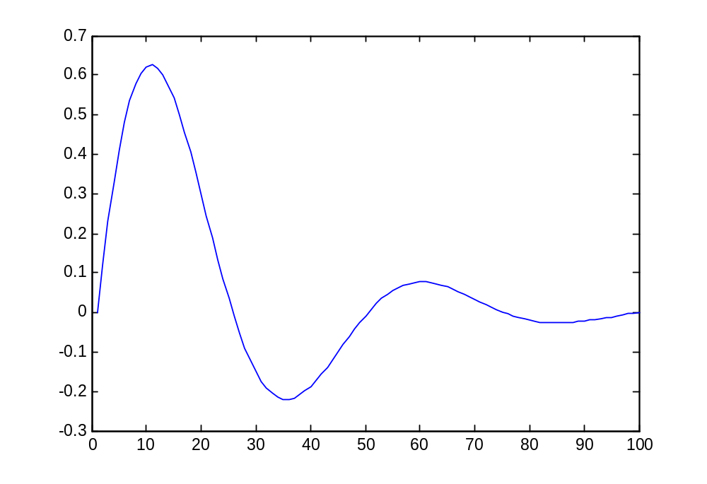
Plots
Plot the function e^{-x/3}sin(x) between 0≤x≤4π
Create an x-array of 100 samples between 0 and 4π.
>>x=linspace(0,4*pi,100);
>>y=sin(x);
>>y1=exp(-x/3);
>>y2=y*y1;
>>y2=y.*y1;
>>plot(y2)

Slide 23
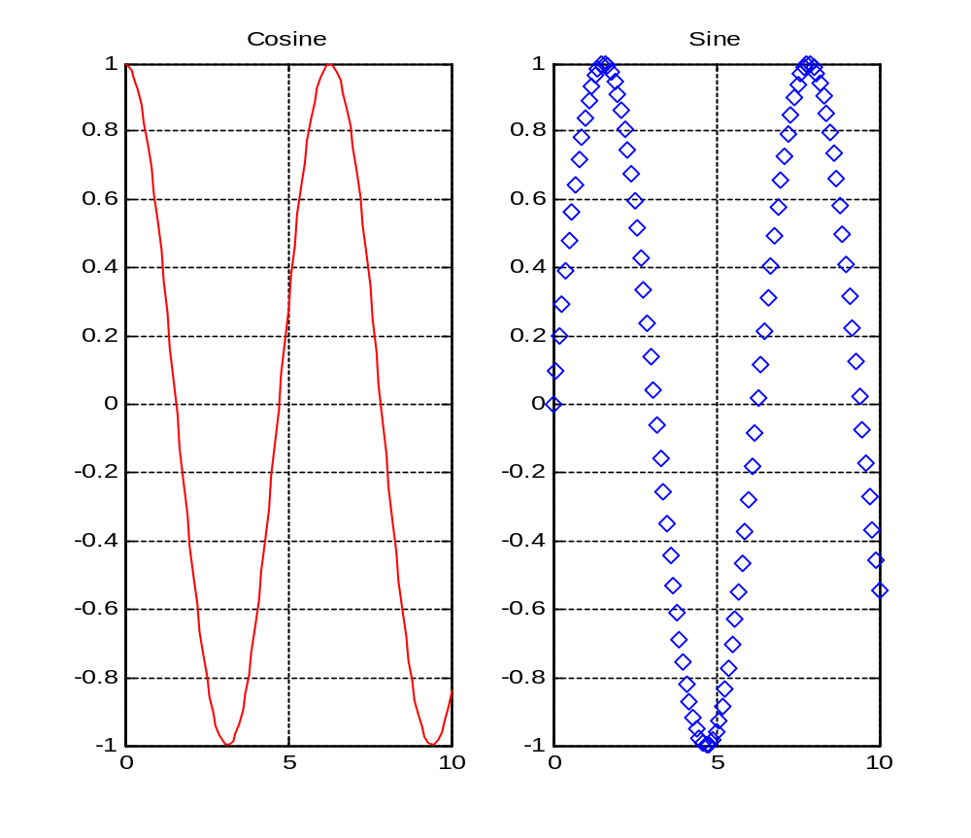
Subplots
Use subplots to divide a plotting window into several panes.
>> x=0:0.1:10;
>> f=figure;
>> f1=subplot(1,2,1);
>> plot(x,cos(x),'r');
>> grid on;
>> title('Cosine')
>> f2=subplot(1,2,2);
>> plot(x,sin(x),'d');
>> grid on;
>> title('Sine');

Slide 24
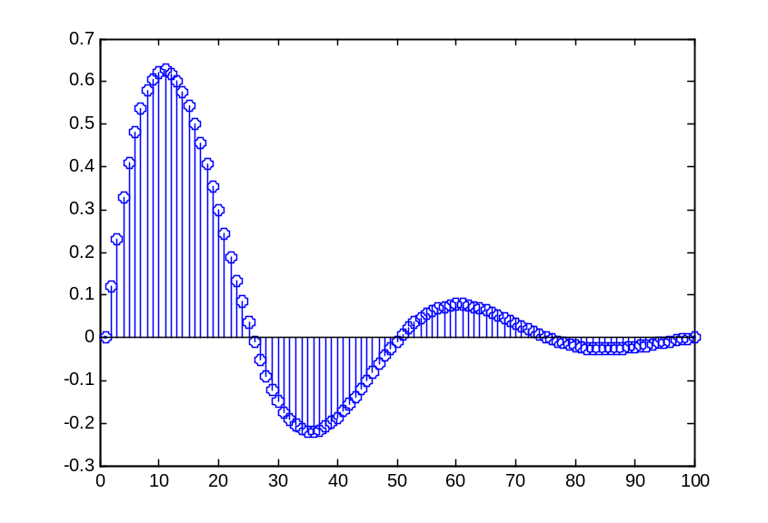
Display Facilities
Plot(.)
>>x=linspace(0,4*pi,100);
>>y=exp(-x/3).*sin(x);
>>plot(y)
>>plot(x,y)
Stem(.)
>>stem(y)
>>stem(x,y)

Slide 25
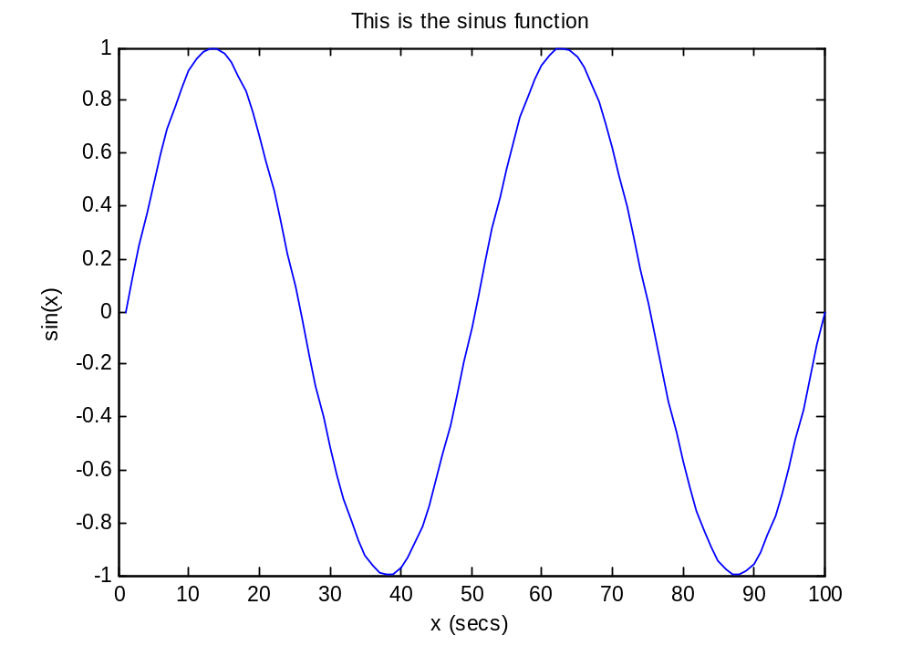
Display Facilities
Title(.)
>>title(‘This is the sinus function’)
Xlabel(.)
>>xlabel(‘x (secs)’)
Ylabel(.)
>>ylabel(‘sin(x)’)

Slide 26
Operators (relational, logical)
== Equal to
~= Not equal to
< Strictly smaller
> Strictly greater
<= Smaller than or equal to
>= Greater than equal to
& And operator
| Or operator

Slide 27
Flow Control
if….elseif….else….end
for….end
while….end

Slide 28
Control Structures
If statement syntax
if (Condition_1)
Matlab Commands
elseif (Condition_2)
Matlab Commands
elseif (Condition_3)
Matlab Commands
else
Matlab Commands
end
if ((a>3) & (b==5))
Some Matlab Commands;
end
if (a<3)
Some Matlab Commands;
elseif (b~=5)
Some Matlab Commands;
end
if (a<3)
Some Matlab Commands;
else
Some Matlab Commands;
end

Slide 29
for i=1:100
Some Matlab Commands;
end
for j=1:3:200
Some Matlab Commands;
end
for m=13:-0.2:-21
Some Matlab Commands;
end
for k=[0.1 0.3 -13 12 7 -9.3]
Some Matlab Commands;
end
For statement Syntax
for i=Index_Array
Matlab Commands
end

Slide 30
While statement syntax
while (condition)
Matlab Commands
end
Example
while ((a>3) & (b==5))
Some Matlab Commands;
end

Slide 31
Example
>>a = 1
>>while length(a) < 10
>>a = [0 a] + [a 0]
>>end
which prints out Pascal’s triangle:
1
1 1
1 2 1
1 3 3 1
1 4 6 4 1
1 5 10 10 5 1
1 6 15 20 15 6 1
1 7 21 35 35 21 7 1
1 8 28 56 70 56 28 8 1
1 9 36 84 126 126 84 36 9 1
(with “a=” before each line).

Slide 32
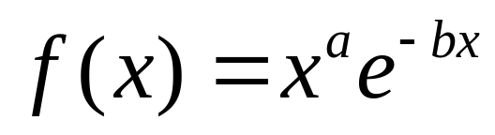
Symbolic Operations
Analytically solving and manipulating symbolic mathematical expressions
In symbolic operations, the variables do not need to have a value
Declare the variables a, b, x as symbolic variables (they do not have numerical values),
  Ex: for a function
>>syms a b x % declare symbolic symbols
>>f = x^a*exp(-b*x)
f =
x^a/exp(b*x)

Slide 33
Symbolic Operations
Differentiation
Find the first derivative of
>> diff_f = diff(f, x)
diff_f =
(a*x^(a - 1))/exp(b*x) - (b*x^a)/exp(b*x)
>> simplify(diff_f)
ans =
(x^(a - 1)*(a - b*x))/exp(b*x)

Slide 34
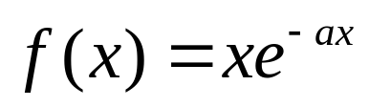
Symbolic Operations
Integration
Find the indefinite integral of
>> syms a x
>> f2 = x*exp(-a*x)
f2 =
x/exp(a*x)
>> int_f = int(f2, x) % indefinite integral
int_f =
-(a*x + 1)/(a^2*exp(a*x))

Slide 35
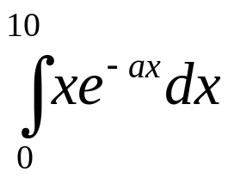
Symbolic Operations
Integration
Calculate
>> int(f2, x, 0, 10)
ans =
1/a^2 - (10*a + 1)/(a^2*exp(10*a))

Slide 36
Substitution
The “subs” command substitute a number of a symbol into a symbolic expression
Example: evaluate the value of
when a=2, b=1, and x=3
>> syms a b x
>> f = x^a*exp(-b*x)
f =
x^a/exp(b*x)
>> subs(f, {a, b, x}, {2, 1, 3})
ans =
0.4481

Slide 37
Substitution
Evaluate the integral of when a=2
>> syms a x
>> f2 = x*exp(-a*x)
f2 =
x/exp(a*x)
>> int_f2 = int(f2, 0, 10)
int_f2 =
1/a^2 - (10*a + 1)/(a^2*exp(10*a))
>> subs(int_f2, a, 2)
ans =
0.2500

Slide 38
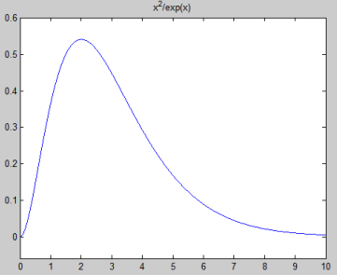
Graphing Functions
Plot when a=2 and b=1 for x in the
range of [0, 10]
>> syms x y a b
>> f = x^a*exp(-b*x);
>> f3 = subs(f, {a, b}, {2, 1})
f3 =
x^2/exp(x)
>> ezplot(f3, [0, 10])

Slide 39
M-file
A sequence of Matlab commands in an external file with extension *.m is usually called an m-file.
Execution of m-file will execute all commands in the file.
Steps:
1. In Matlab, click on file New Script to load the default editor
2. In editor type the commands
3. Save the file. In the editor, click on File save filename.m
4. Execute the file. In the editor, click on Debug Run filename.m

Slide 40
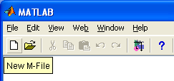
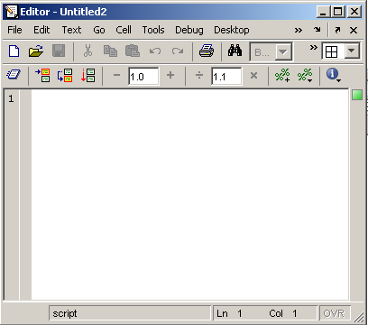
M-file
Click to create a new M-file

Slide 41
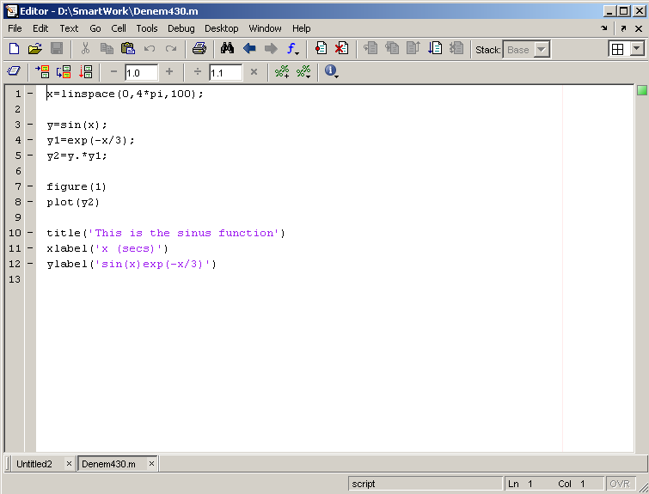
Extension “.m”
A text file containing script or function or program to run

Slide 42
An M-file should start with
clc
clear all
close all
These three command make it so past data is not
linked with the new file.
Important: The m-file to be executed must be in the current working directory.

Slide 43
Writing User Defined Functions
Functions are m-files which can be executed by specifying some inputs and supply some desired outputs.
The code telling the Matlab that an m-file is actually a function is
function out1=functionname(in1)
function out1=functionname(in1,in2,in3)
function [out1,out2]=functionname(in1,in2)
You should write this command at the beginning of the m-file and you should save the m-file with a file name same as the function name

Slide 44
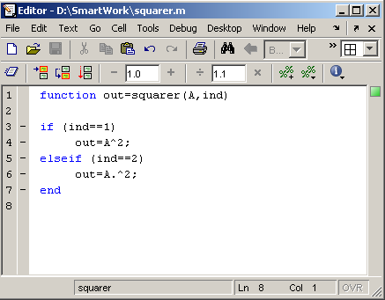
Examples
  Write a function : out=squarer (A, ind)
    Which takes the square of the input matrix if the input indicator is equal to 1
    And takes the element by element square of the input matrix if the input indicator is equal to 2
Same Name

Slide 45
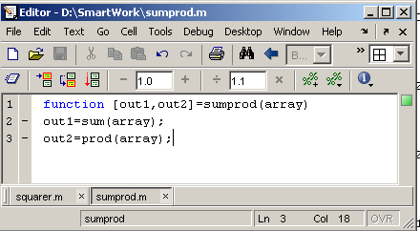
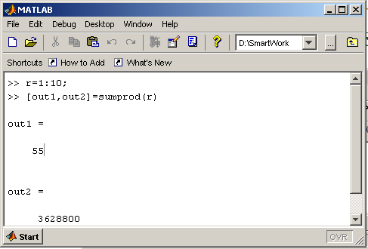
Another function which takes an input array and returns the sum and product of its elements as outputs
The function sumprod(.) can be called from command window or an m-file as

Slide 46
Some built-in Functions
zeros(M,N) MxN matrix of zeros
>>x = zeros(1,3)
x =
0 0 0
ones(M,N) MxN matrix of ones
>>x = ones(1,3)
x =
1 1 1

Slide 47
Some built-in Functions
mean(A):mean value of a vector
max(A), min (A): maximum and minimum.
sum(A): summation.
sort(A): sorted vector
median(A): median value
std(A): standard deviation.
det(A) : determinant of a square matrix
dot(a,b): dot product of two vectors
cross(a,b): cross product of two vectors
inv(A): Inverse of a matrix A

Slide 48
cos(x): Cosine
sin(x): Sine
tan(x): Tangent
acos(x): Arc cosine
asin(x): Arc sine
atan(x): Arc tangent
exp(x): Exponential
sqrt(x): Square root
log(x): Natural logarithm
log10(x): Common logarithm
abs(x): Absolute value
round(x): Round to nearest integer
rem(x): Remainder after division
angle(x): Phase angle
conj(x): Complex conjugate
Use Help command to get more information

Slide 49
Getting Help
Use help command_name
The help command is your best friend!
When not sure about a command, always use help!
Example
>> help sqrt
sqrt Square root.
sqrt(X) is the square root of the elements of X. Complex results are produced if X is not positive.
See also sqrtm, realsqrt, hypot.
Reference page in Help browser
doc sqrt

Slide 50
Find a command for a certain operation
Use the lookfor keyword command
The command returns a list of Matlab functions that has keyword in the first section of the help file.
Example
I want to find a command that can play audio files.
>> lookfor audio
audioplayer -Audio player object.
audiorecorder -Audio recorder object.
audiodevinfo -Audio device information.
audioinfo - Information about an audio file.
audioread - Read audio files
audiorecorderreg -Audioplayerreg
audiouniquename -Assign unique variable name in workspace.
audiowrite - write audio files
avgate
…

Slide 51
Conclusion
Let’s Try It

